Slide 1
CSE 3212: Compiler Design Laboratory
Nazia Jahan Khan Chowdhury
Dipannita Bishwas

Slide 2
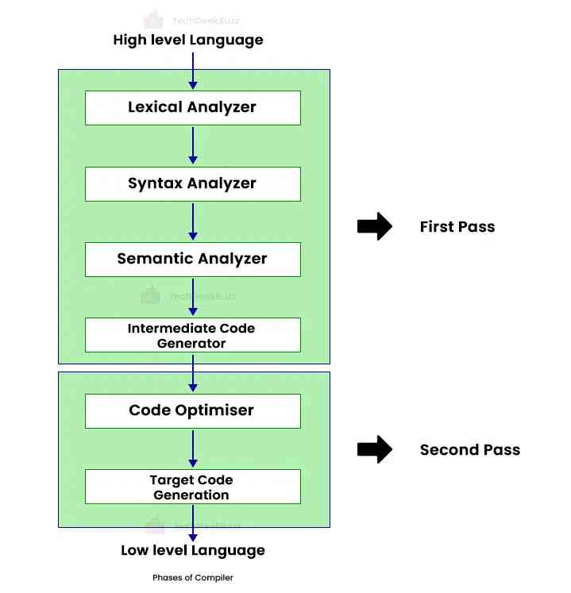
Compiler 6 phases

Slide 3
Lexical Analysis: Dividing the input into meaningful units. For a C program the units are variables, constants, keywords, operators, punctuation etc. These units also called as tokens. (we will use Flex)
Flex: A fast Lexical Analyzer Generator
Parsing: Involves finding the relationship between input tokens. For a C program, one needs to identify valid expressions, statements, blocks, procedures etc. (Use Bison)

Slide 4
FLEX
Flex is a tool for generating scanners.
Flex source is a table of regular expressions and corresponding program fragments.
Generates lex.yy.c which defines a routine yylex()

Slide 5
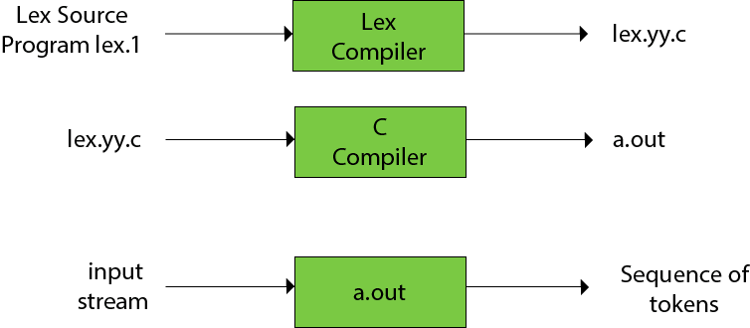
FLEX

Slide 6
FLEX SPECIFICATIONS
{ definitions }
%%
{ rules }
%%
{ user subroutines }

Slide 7
FLEX SIMPLE EXAMPLE
%%
. {printf("Character");}
%%
int yywrap()
{
}
main()
{
yylex();
printf("Hello World");
}

Slide 8
Commands to run flex file
flex filename.l
gcc lex.yy.c –o a
a

Slide 9
DEFINITIONS
The definitions section contains declarations of simple name definitions to simplify the scanner specification, and declarations of start conditions,
Name definitions have the form:
name definition
DIGIT [0-9]
ID [a-z][a-z0-9]*

Slide 10
RULES
The rules section of the flex input contains a series of rules of the form:
pattern action
where the pattern must be unintended and the action must begin on the same line.

Slide 11
FLEX ACTIONS
Actions are C source fragments. If it is compound, or takes more than one line, enclose with braces (’{’ ’}’).
Example rules:
[a-z]+ printf("found word\n");
[A-Z][a-z]* { printf("found capitalized word:\n");
printf(" ’%s’\n",yytext);
}

Slide 12
FLEX Patterns
Lexical Analysis With Flex, for Flex 2.6.3: Patterns (virginia.edu)

Slide 13
Detect Positive or Negative Integer
%%
[+]?[0-9]+ {printf("positive integer\n");}
[-]?[0-9]+ {printf("negative integer\n");}
%%
int yywrap()
{
return 1;
}
int main()
{
printf("positive and negative integer recognition\n");
yylex();
return 0;
}

Slide 14
Thank you

